Slide 1

Classifying Loan Credibility
Team 23:
Kate Zagrebneva | Prashasti Sharma
My Han Mai | Noor Zia | Samira Shafiei

Slide 2
Business Idea
“Provide quick, immediate, and easy way to identify and classify the credibility of loan applicants who are most likely to get a loan approval.”

Slide 3
Questions
Which machine learning technique is best to classify credibility of loan applicant based on basic applicant information?
What factors impact loan applicant credibility?

Slide 4
Exploratory Data Analysis

Slide 5
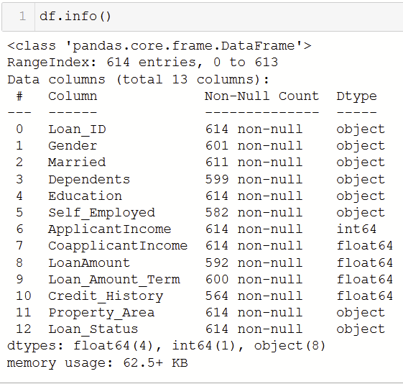
Dataset
Data Source:
Kaggle’s Loan Eligible Dataset
Dataset size:
(614, 13)
Data Types:
Categorical, Numeric

Slide 6
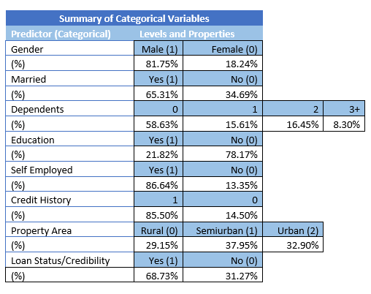
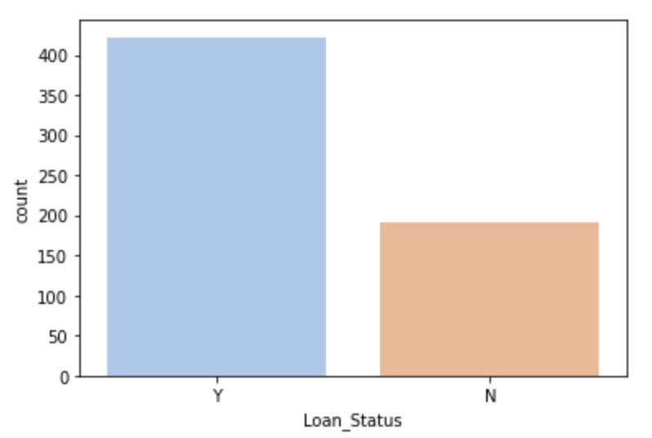
Summary of Categorical Variables
Yes: 422 No: 192

Slide 7
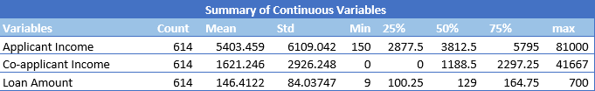
Summary of Numeric Variables

Slide 8
Preprocessing
“ data scientists spend 80% of their time cleaning data”

Slide 9
Common steps of preprocessing :
Treatment of Outliers:
Checking for duplicates
Dropping irrelevant columns: Loan_ID column
Handling missing values
Mean
Mode
Label Encoding
Binning and dropping the extreme instances
Combining attributes and Performing normalization using logarithmic function

Slide 10
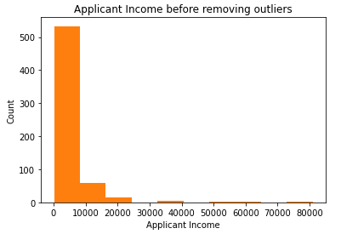
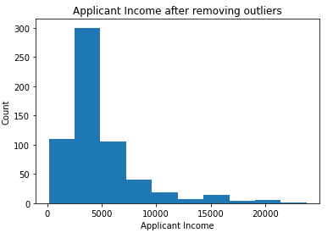
Removing outlier using Binning

Slide 11
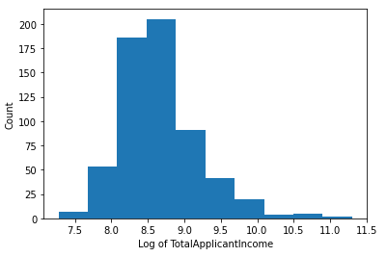
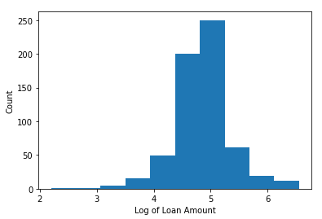
Removing outlier using logarithmic function

Slide 12
Our Selected Techniques
Naive Bayes
Logistic Regression
Decision Trees
Random Forest

Slide 13
Preprocessing Techniques used to improve model accuracy -
Naive Bayes | Feature Scaling
Logistic Regression | Recursive Feature Elimination, Stratified K-Fold Cross Validation
Decision Tree | Feature Selection using Gini Impurity Index
Random Forest | Stratified K-Fold Cross Validation

Slide 14
Naive Bayes
Method | Accuracy
Naïve Bayes before any preprocessing (Weka) | 79.64%
Naïve Bayes with Outliers (without Feature Scaling) | 82.16%
Naïve Bayes with Outliers (with Feature Scaling) | 82.16%
Naïve Bayes without Outliers (Binning) | 79.44%
Naïve Bayes without Outliers (Binning + Feature Scaling) | 79.44%
Naïve Bayes without Outliers (Normalization using log function) | 82.70%
Naïve Bayes without Outliers (Normalization using log + Feature Scaling) | 82.16%
Notes:
Result -
Feature Scaling did not impact the model performance in any of the case.
Naive Bayes model worked best with data without outliers. Out of the two outlier elimination methods, normalization gave the best results.

Slide 15
Logistic Regression
Method | Accuracy
Logistic Regression before Preprocessing (Weka) | 80.94%
Logistic Regression with Outliers | 83.24%
Logistic Regression with Outliers + RFE | 82.70%
Logistic Regression with Outliers + RFE + K-fold Cross Validation | 80.19%
Logistic Regression without Outliers using Binning | 79.44%
Logistic Regression without Outliers using Binning + RFE | 70.55%
Logistic Regression without Outliers using Binning + RFE + K-fold CV | 82.14%
Logistic Regression without Outliers by normalization using log function | 82.70%
Logistic Regression without Outliers (normalization) + RFE | 82.70%
Logistic Regression without Outliers (normalization) + RFE + K-fold CV | 80.19%
Notes:
Result - Out of the many model variations, Logistic Regression with outliers resulted in highest accuracy. We can infer that Logistic Regression was able to classify loan customer better with the outlying data points.

Slide 16
Decision Tree
Method | Accuracy
Decision Tree (No preprocessing - Weka) | 80.94%
Decision Tree (With Outliers) | 76.22%
Decision Tree (After Feature Selection) | 76.76%
Decision Tree (Without Outliers using binning) | 74.44%
Decision Tree (Without Outliers using normalization) | 67.57%
Notes:
Results - Attributes with highest Gini Impurity Index (0.43) were dicarded and the model performance showed improved.

Slide 17
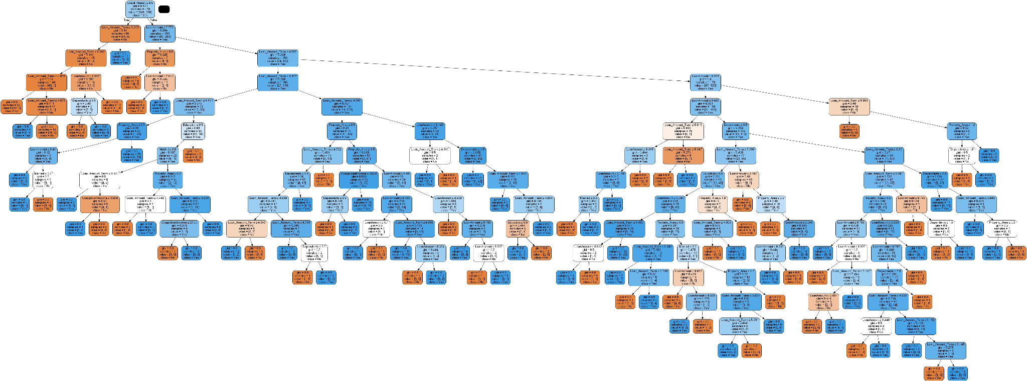
For Better View of Decision Tree: https://imgur.com/n6Vbcpg

Slide 18
Random Forest
Method | Accuracy | AUC
Random Forest without Preprocessing (Weka) | 77.85%
Random Forest with Outliers | 77.63% | 0.690
Random Forest without Outliers using binning | 80.23% | 0.815
Random Forest without Outliers using normalization | 79.72% | 0.7241

Slide 19
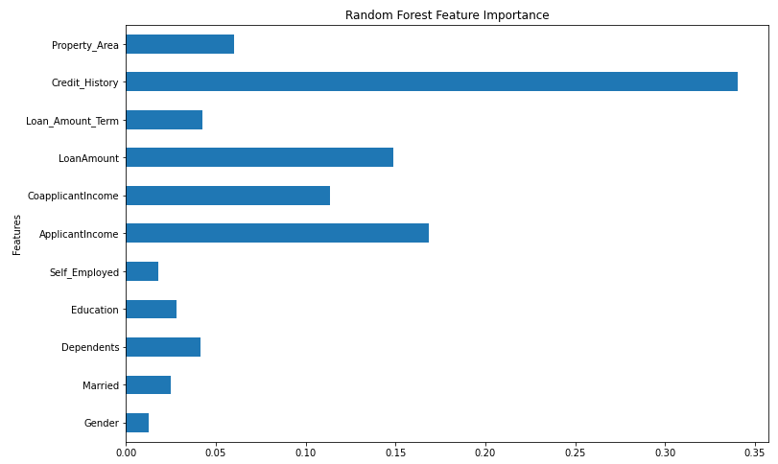
Attributes Impacting Loan Applicant Credibility

Slide 20
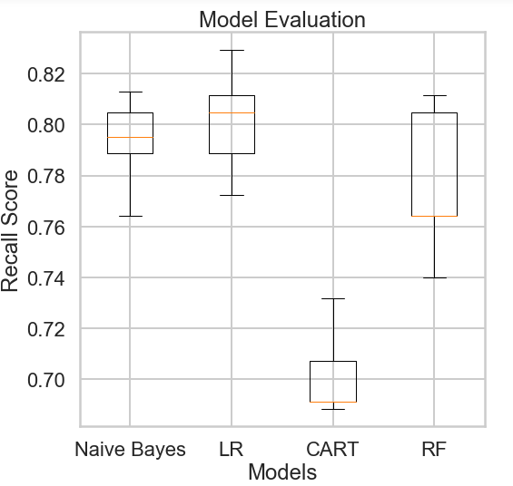
Model Comparison

Slide 21
Best Model
Most Impactful Variable
Reasons Why
Logistic Regression with Outliers (no RFE + no K-Fold CV) - 83.24%
Credit History
Logistic Regression had a higher accuracy percentage and takes outliers into account to perform classification accurately. We also found the most impactful variable was Credit History because it provided the highest feature importance value using the feature importance function of sklearn.

Slide 22
Thank You!
Any questions?

